Slide 1





Roma, 5 ottobre 2018
“Nanomaterials and advanced solutions for the restoration of Cultural Heritage”
Innovative packaging solutions for storage and conservation of 20th century cultural heritage of artefacts
based on cellulose derivative
Andrea DE POLO SAIBANTI
FRATELLI ALINARI IDEA SPA
GA760801 funded by

Slide 2
THE FACTS
  “We all die, but looking” is the title of the autobiography of Alberto García Alix, one of the most representative photographers of 2nd half of 20th Century in Europe.
  These physical supports have saved main part of our global cultural, social and political history. But, looking into each individual, also gave the possibility of recording part of our family heritage.

Slide 3


Photographies that showed our social reality.

Slide 4


Iconic samples of our recent history.

Slide 5
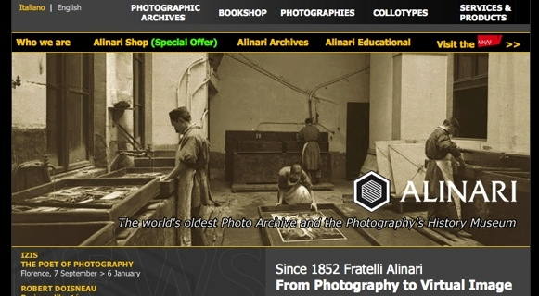
Background info about Alinari Photographic archive

Slide 6
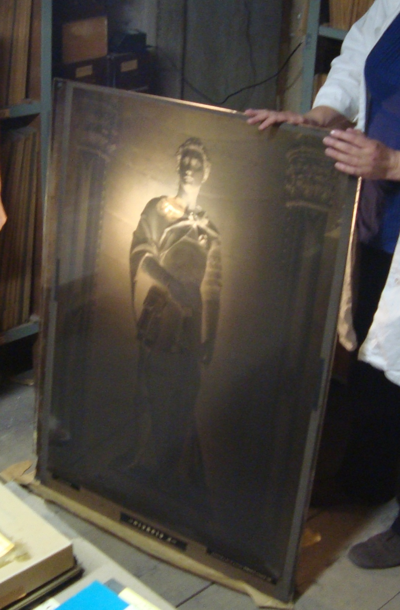

Slide 7
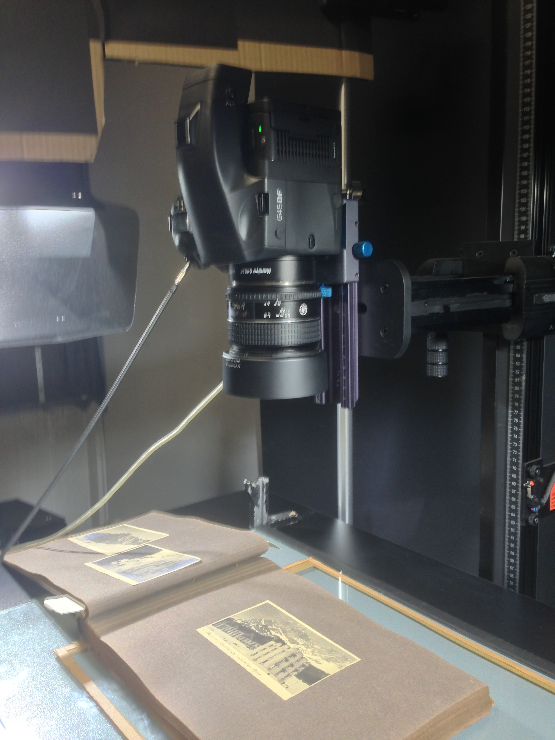
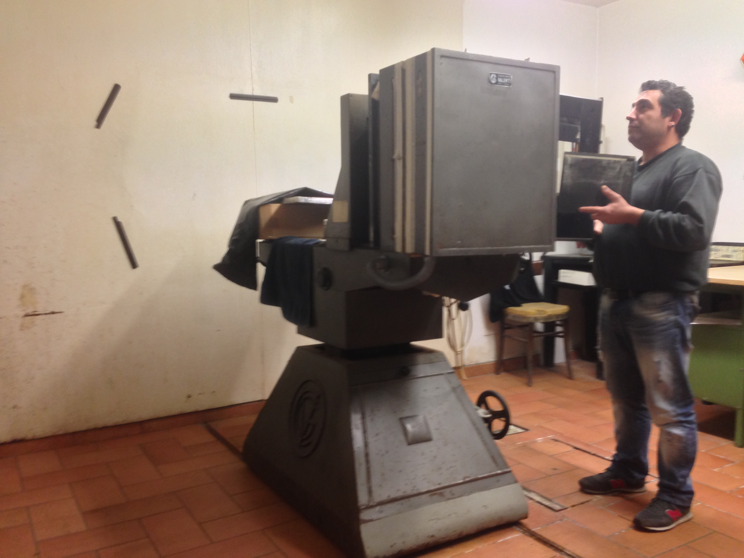
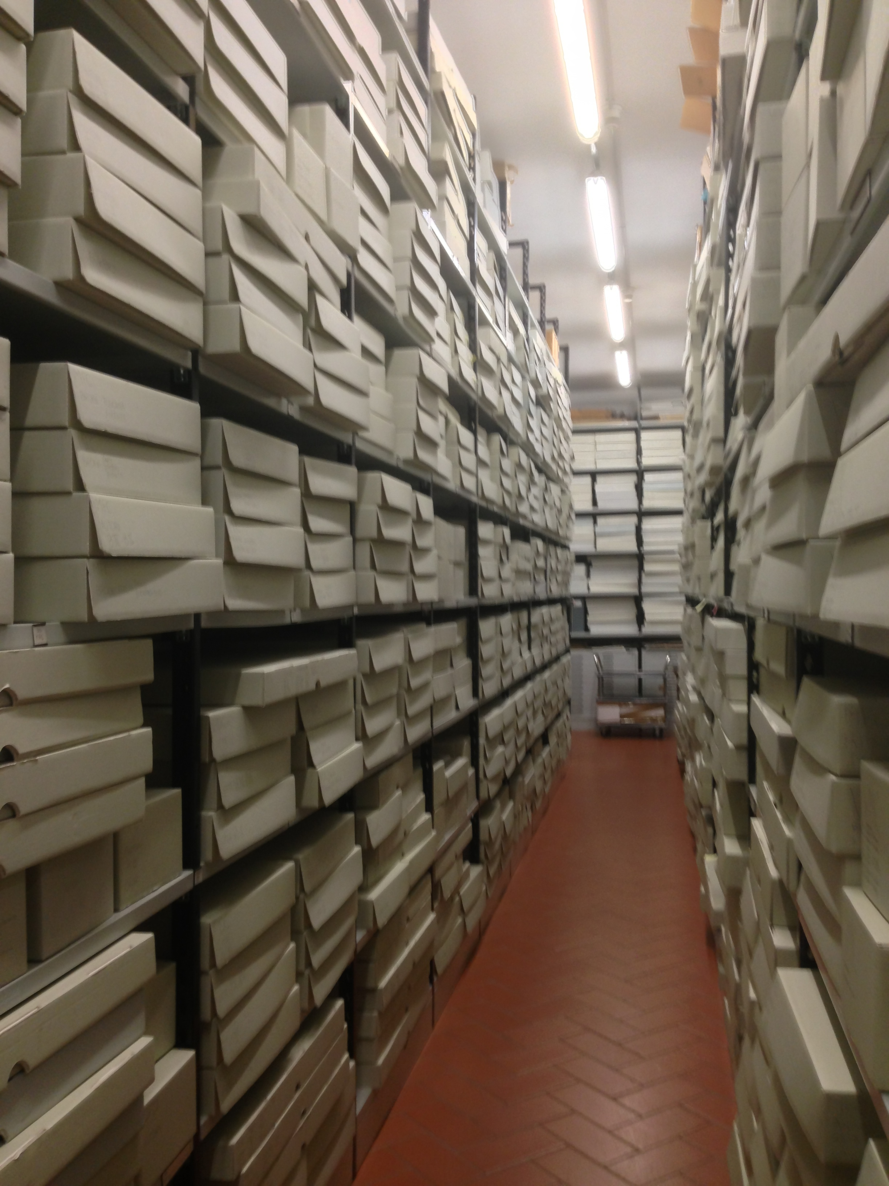
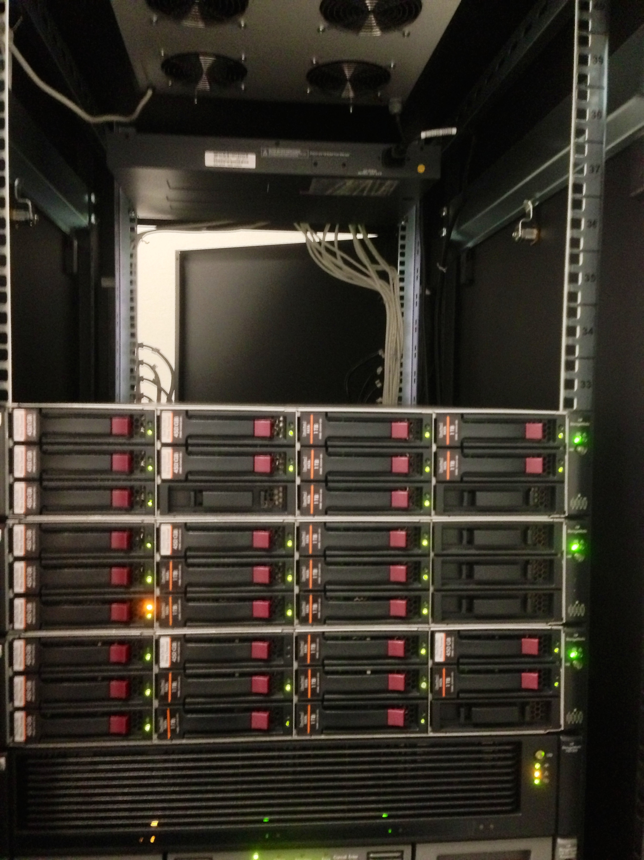
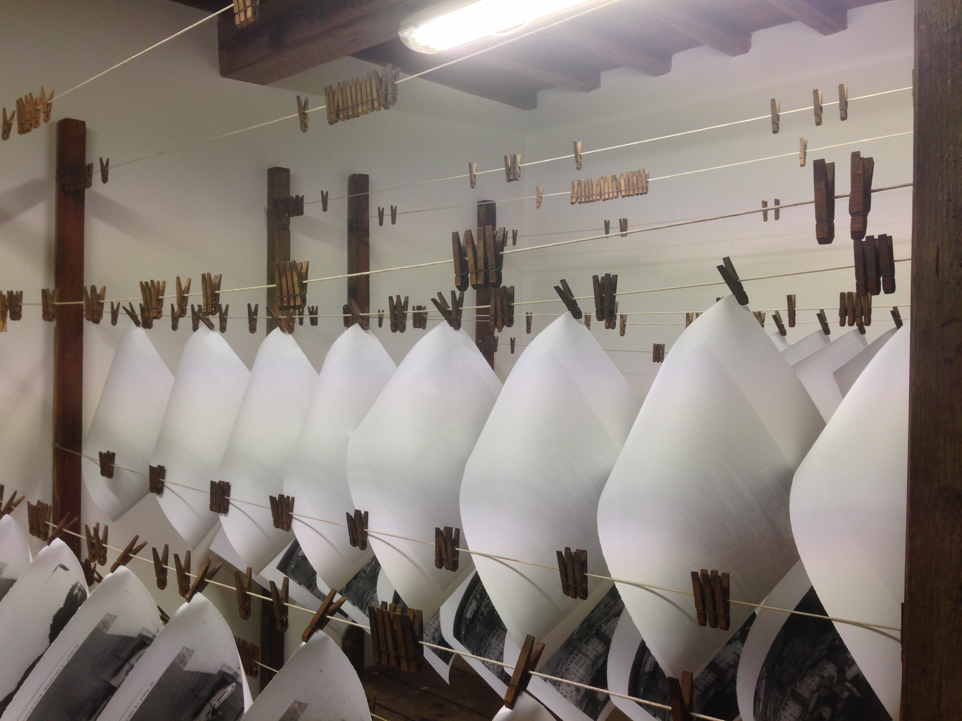
ALINARI TODAY:

Slide 8
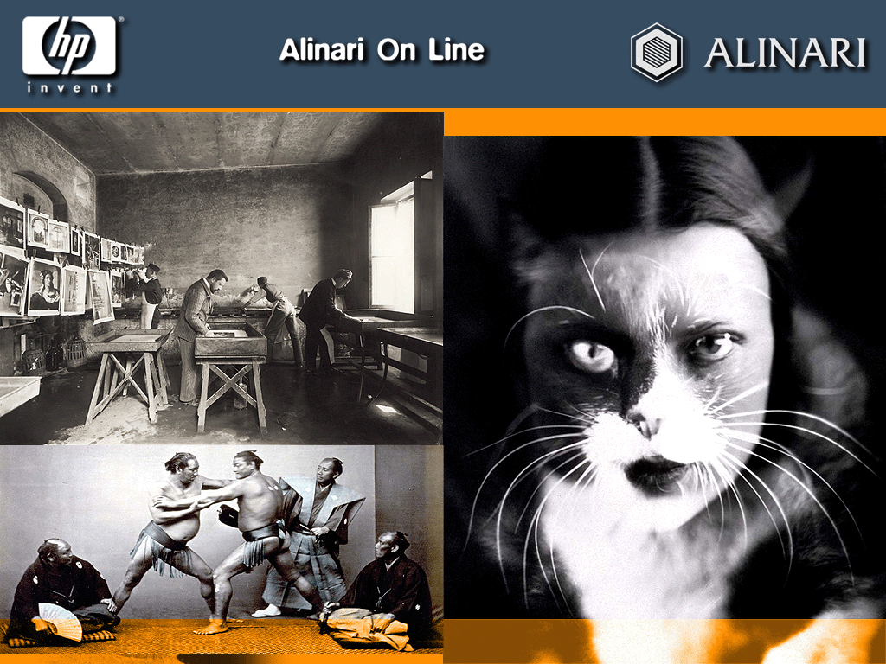


Slide 9


Slide 10
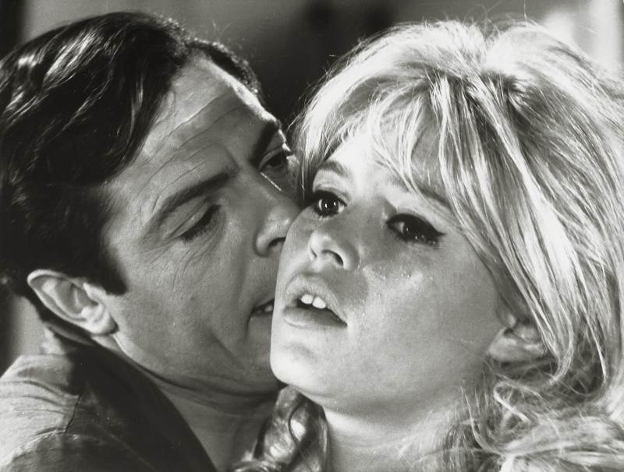

Slide 11
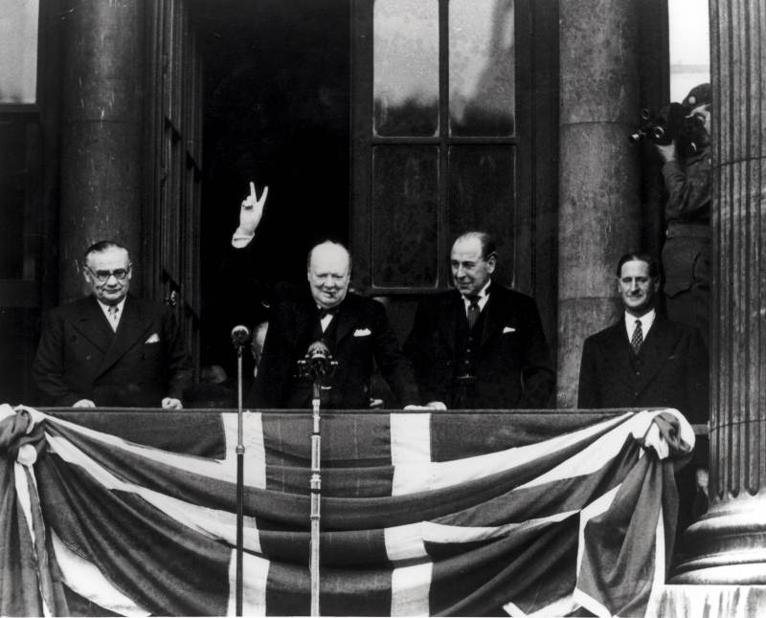

Slide 12
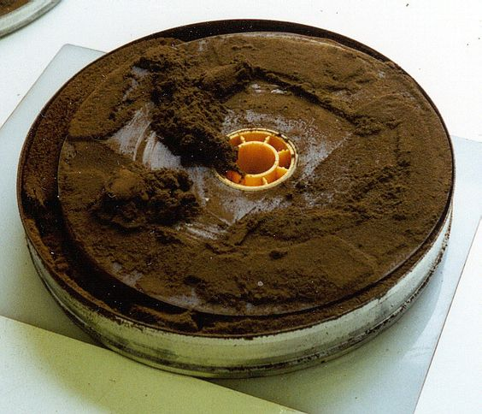
Nemosine
"The need"
The context:
  A huge percentage of the recent European cultural heritage (CH) can be found in movies, photographs, posters and slides produced between 1895 to nowadays were made using cellulose derivatives.
  The worldwide estimation of such holdings within professional film archives is around 18 Mio of film reels on cellulose acetate, whereof ca. 5% are in a critical stage or showing signs of vinegar syndrome.

Slide 13
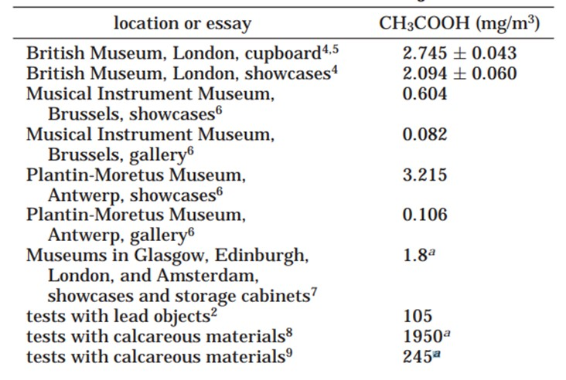
VINEGAR SYNDROME
Acetic acid is released during the initial acetate base deterioration, leading to the characteristic vinegar odor. A critical objective is the removing of acetic acid in the environment to avoid chain degradation reactions.
NEMOSINE will apply innovative MOF (Metallic Organic Frameworks) as acetic adsorbers to minimize vinegar syndrome.
Acetic Acid presence in Museums

Slide 14



NEMOSINE OBJECTIVES
The Key Objectives:
  NEMOSINE aims to improve the traditional storage solutions, by developing an innovative smart package with the main goal of energy saving and extent conservation time of cultural objects based on cellulose derivatives.

Slide 15


NEMOSINE OPPORTUNITY
► The smart package will have the following characteristics:
► High O2 barrier and Active packaging using non-odor additives.
► Active acid absorbers based on functionalized Metal Organic Framework (MOFs) integrated in low density and porous structures.
► Gas detection sensors based on nanotechnology to monitoring AA, water, O2 & NO.
► Multi-scale modelling to correlate degradation & sensors signals.
► Packaging with modular design to fulfil the technical & economical requirements of the different CH made by cellulose derivatives.
► Curative packages containing controlled release of natural antifungal additives.

Slide 16

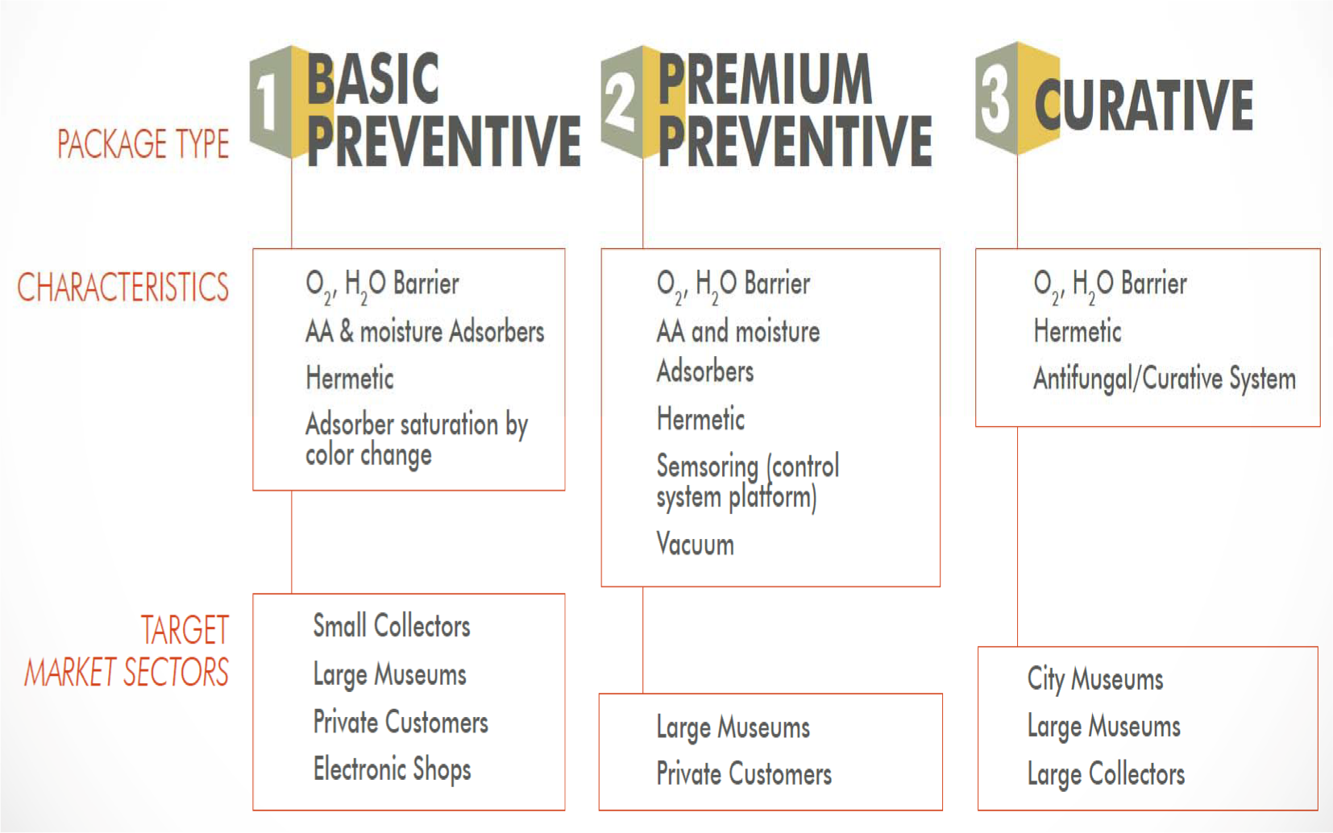
NEMOSINE SOLUTIONS
D The SMART PACKAGE solutions:
D The modular concept of a whole protective device would allow to generate three different packages with different functionalities and final cost, depending on the technical protective/ preventive or curative purposes of cultural objects.

Slide 17

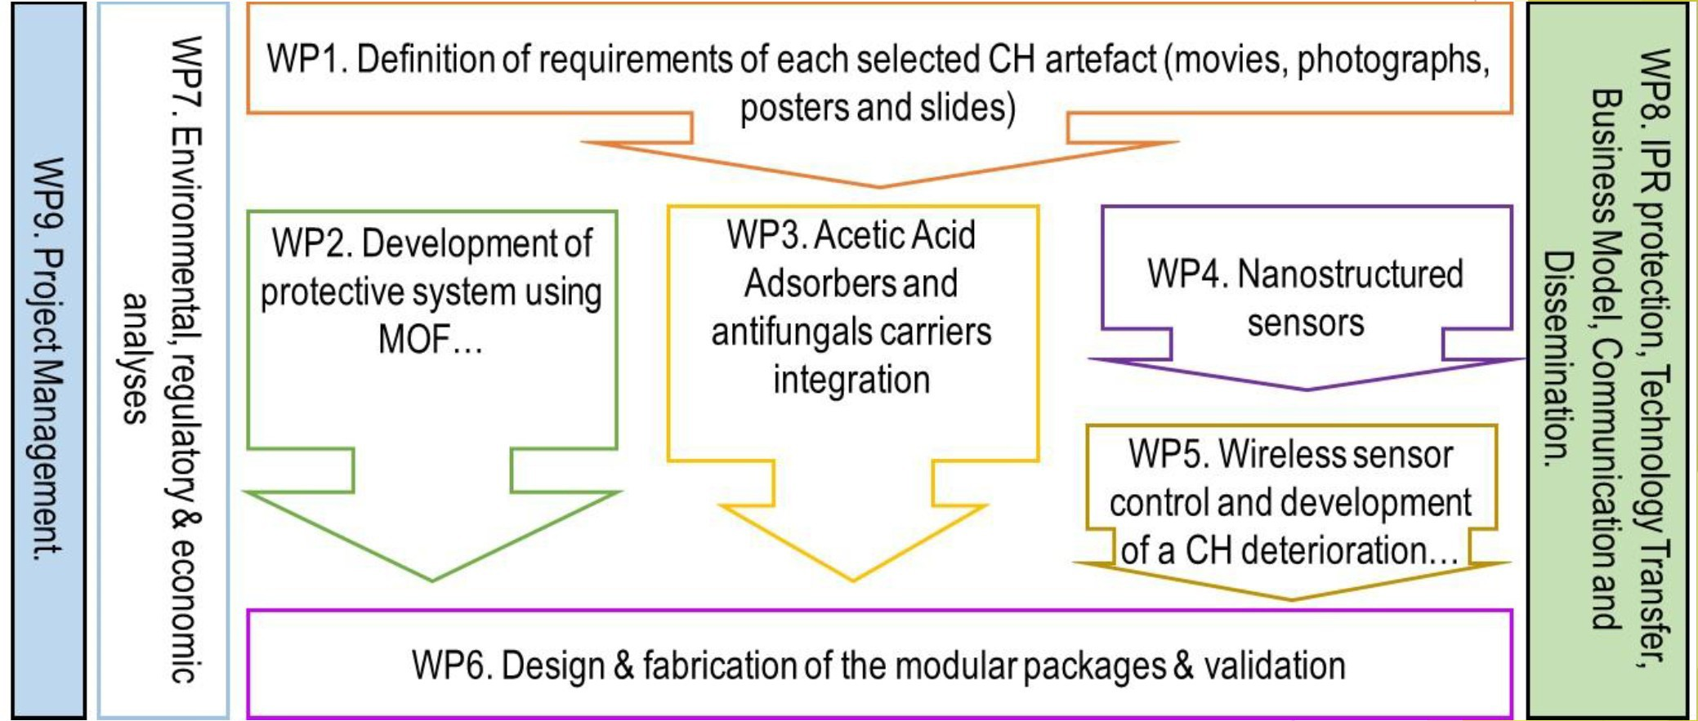
NEMOSINE WORKPLAN
□ Workpackages inter-relationship (PERT):

Slide 18
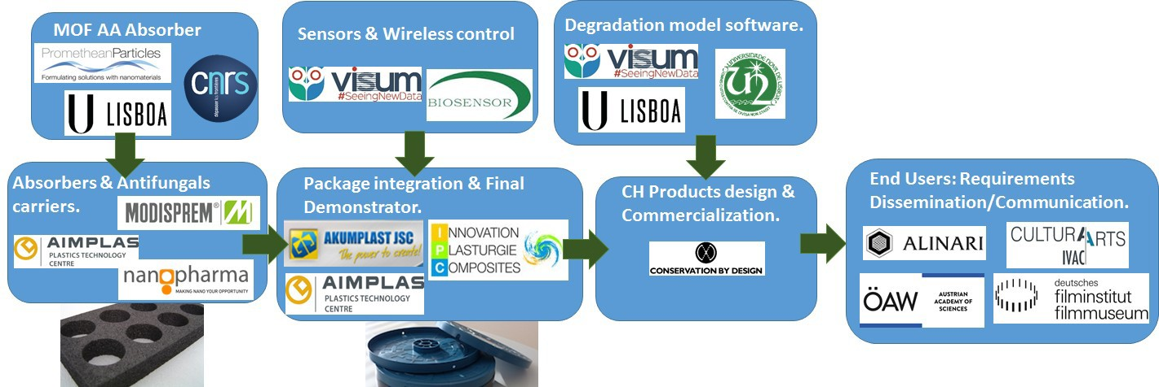
NEMOSINE CONSORTIUM

Slide 19



Thanks for your attention!
ANDREA.DEPOLO@ALINARI.IT
WWW.ALINARI.COM
WWW.NEMOSINEPROJECT.EU
GA760801 funded by

