Slide 1





NanoInnovation 2018
“Nanomaterials and advanced solutions for the restoration of Cultural Heritage”
Innovative packaging solutions for storage and conservation of 20th century cultural heritage of artefacts
based on cellulose derivative
PAOLA DE POLO SAIBANTI
FRATELLI ALINARI IDEA SPA
GA760801 funded by

Slide 2
THE FACTS
  “We all die, but looking” is the title of the autobiography of Alberto García Alix, one of the most representative photographers of 2nd half of 20th Century in Europe.
  The human flair of converting images into memories contribute on building what we were, what we are and surely what we will be.
  Since last 1895 the memories of history of human being has being helped by the possibility of capturing and saving this part of our evolution into photographs and movies. These physical supports have saved main part of our global cultural, social and political history. But, looking into each individual, also gave the possibility of recording part of our family heritage.

Slide 3

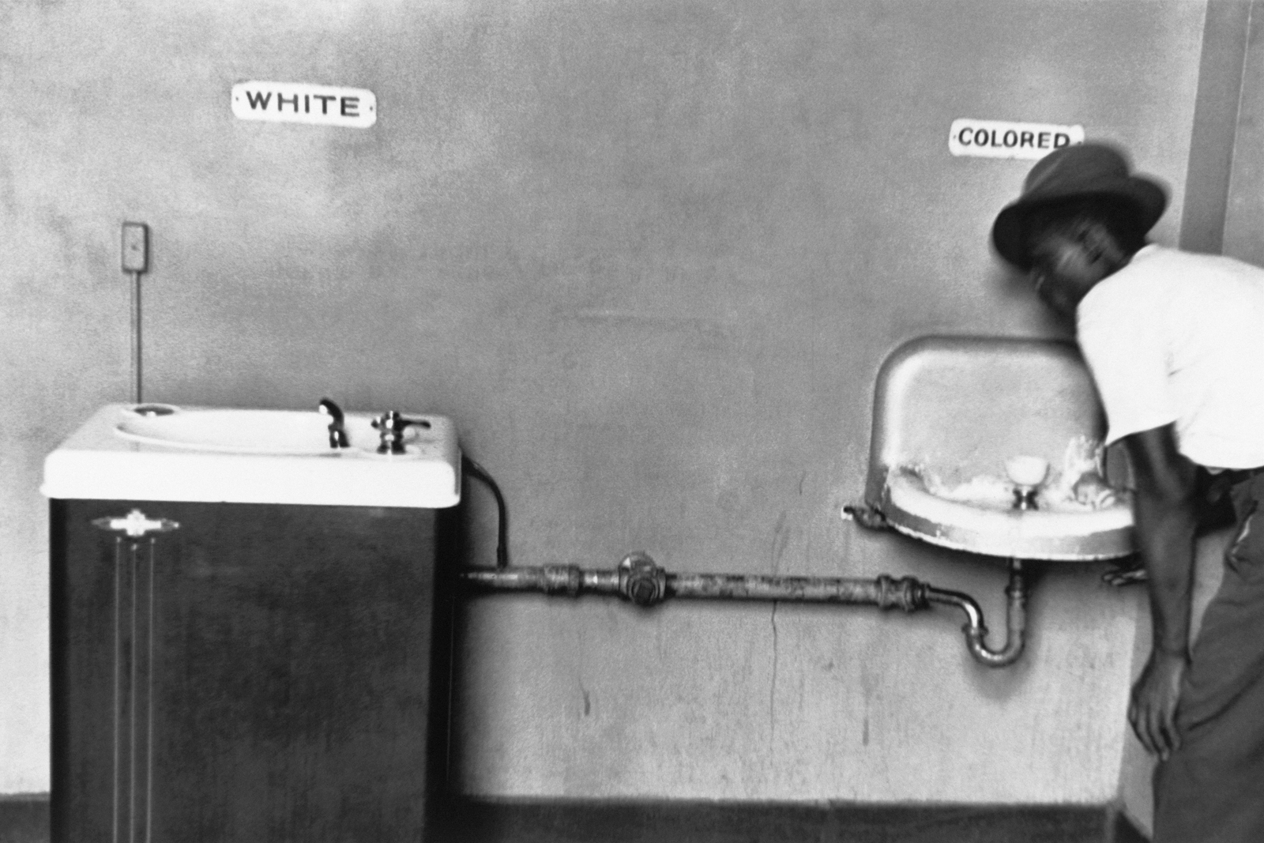
Fotographies that showed our social reality.

Slide 4

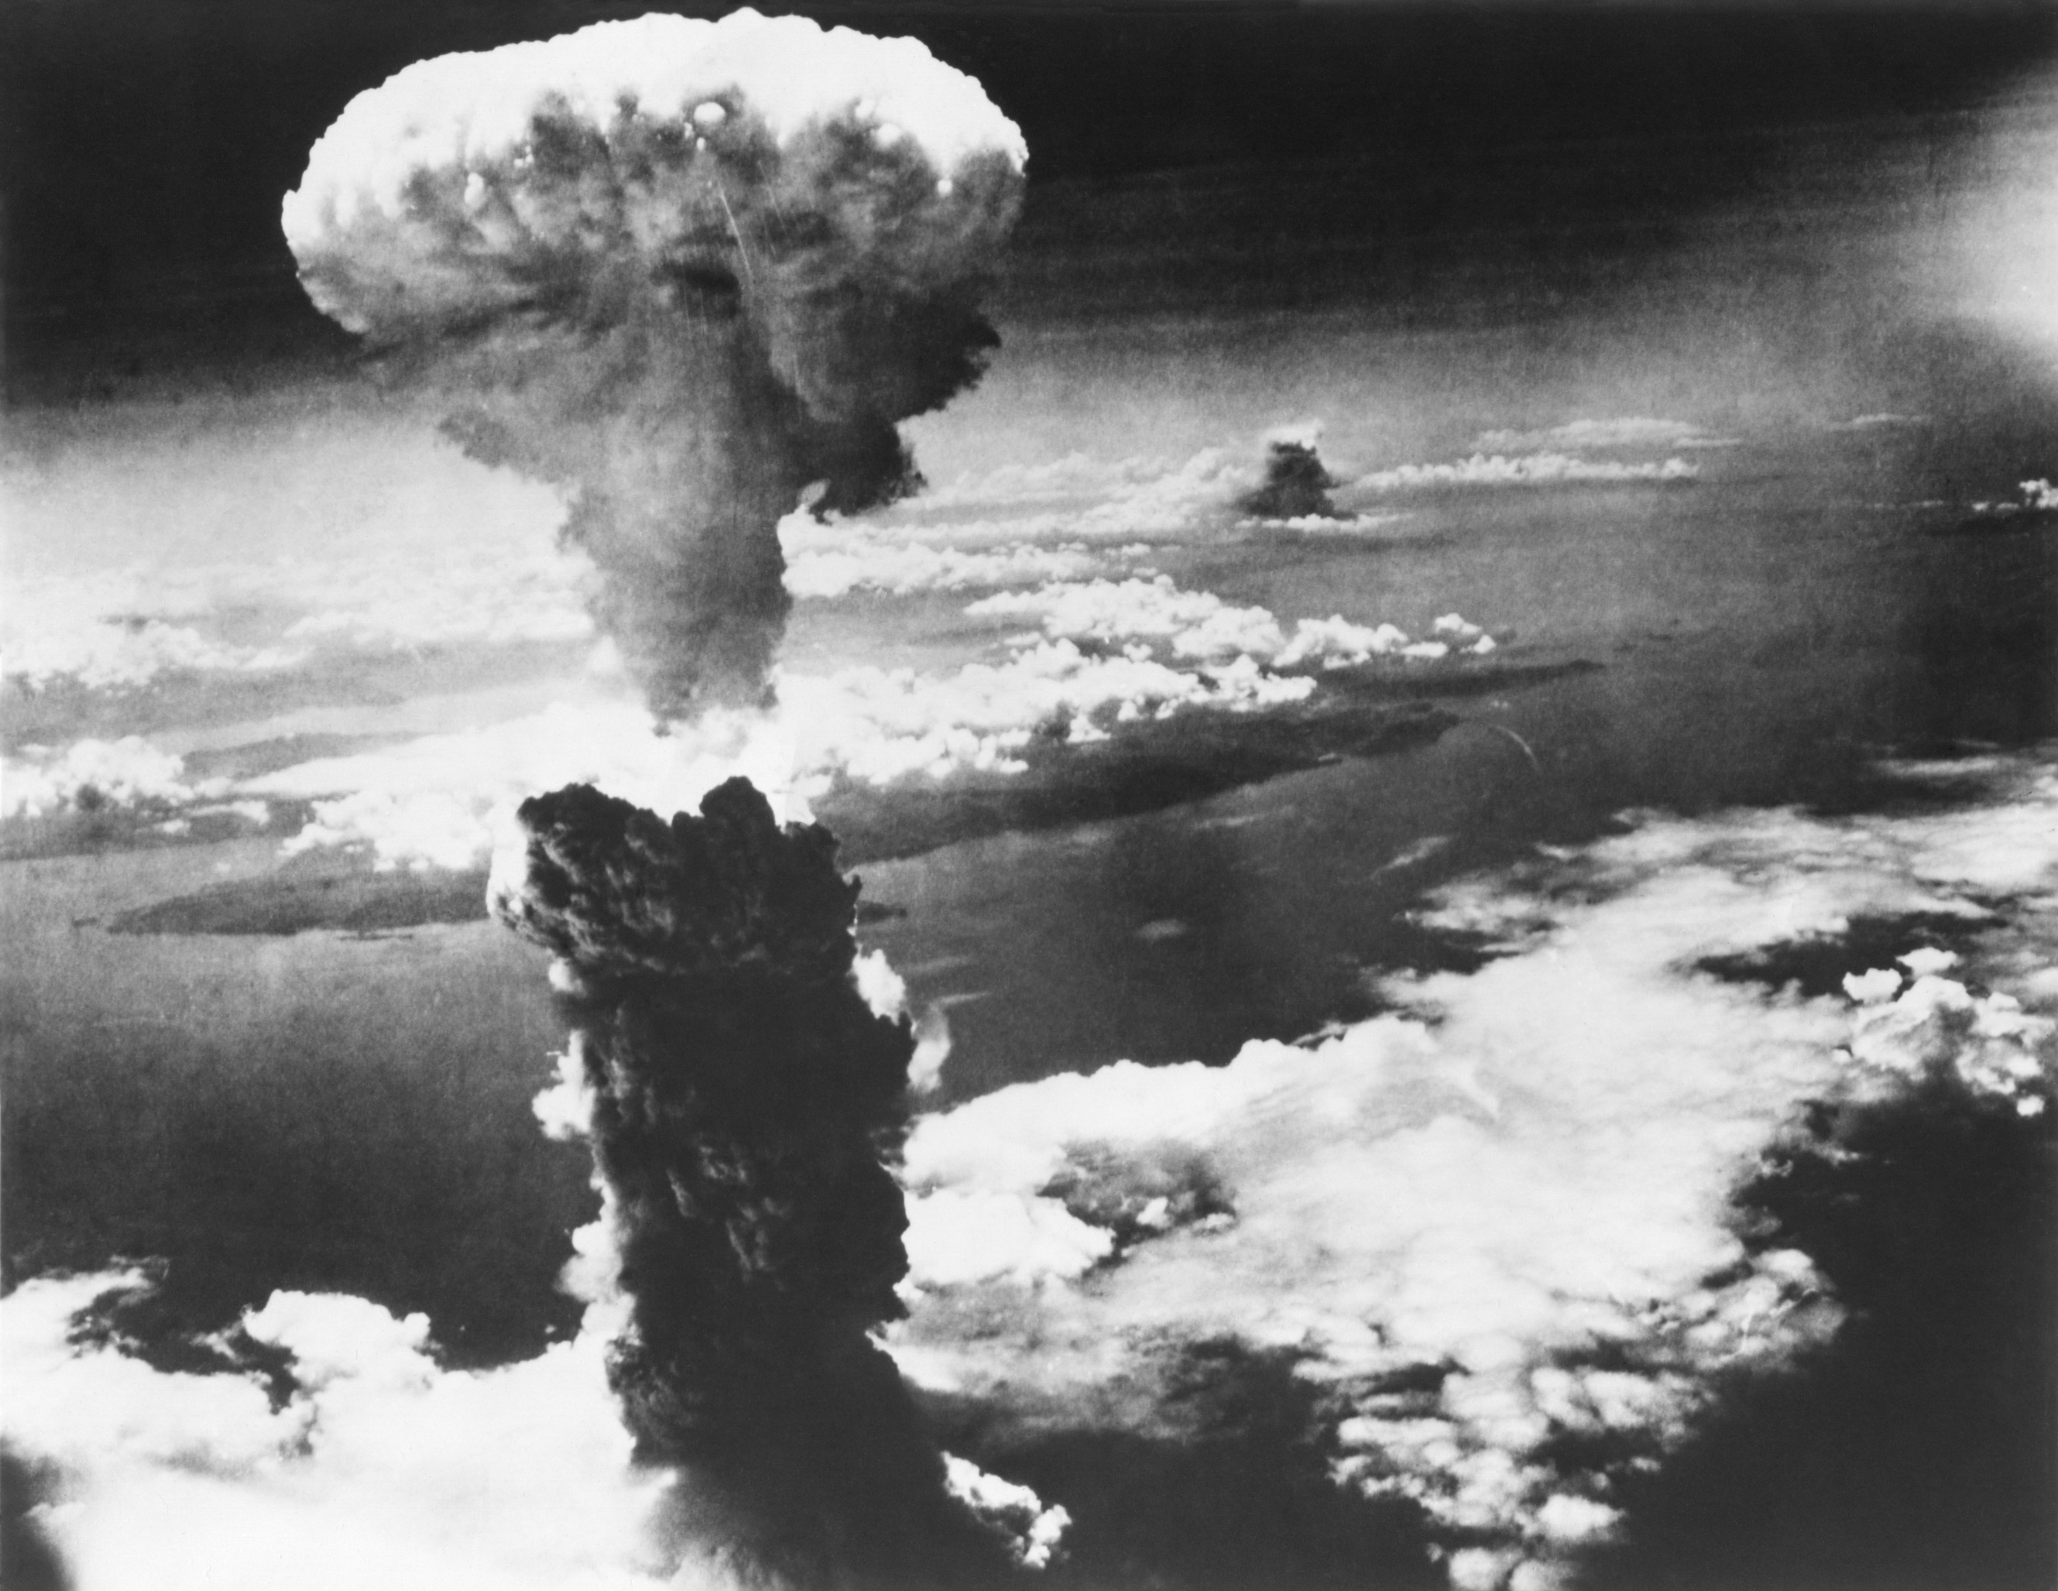
Iconic samples of our recent history.

Slide 5
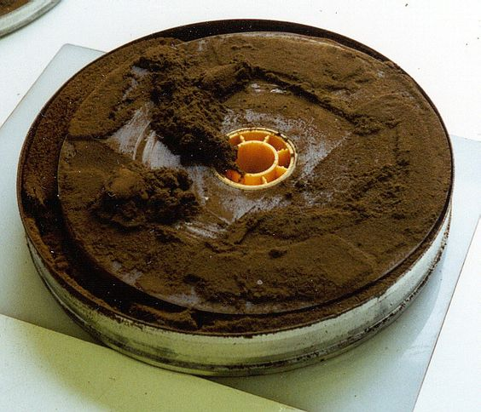
THE NEED
The context:
  A huge percentage of the recent European cultural heritage (CH) can be found in movies, photographs, posters and slides produced between 1895 to nowadays were made using cellulose derivatives.
  The worldwide estimation of such holdings within professional film archives is around 18 Mio of film reels on cellulose acetate, whereof ca. 5% are in a critical stage or showing signs of vinegar syndrome.

Slide 6



NEMOSINE INTRODUCTION
□ Thefacts:
□ A huge percentage of the recent European cultural heritage (CH) can be found in movies, photos posters and slides produced
between 1895 to nowadays were made using cellulose derivatives.
□ The worldwide estimation of such holdings within professional film archives is around 18 Mio of film on cellulose acetate, whereof ca. 5% are in a critical stage or showing signs of vinegar syndrome.
□ There have had other technical approaches to solve this real problem that follow the line of replication and copy the original ones in modern digital supports but, they do not give the possibility of a real preservation of the original ones.

Slide 7
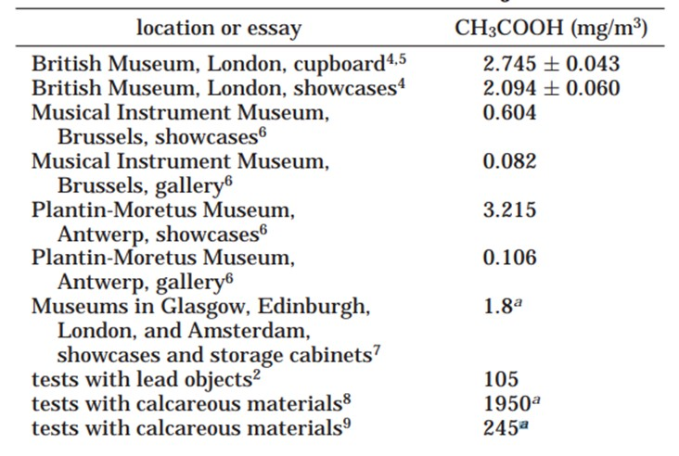
VINEGAR SYNDROME
Acetic acid is released during the initial acetate base deterioration, leading to the characteristic vinegar odor. A critical objective is the removing of acetic acid in the environment to avoid chain degradation reactions.
NEMOSINE will apply innovative MOF (Metallic Organic Frameworks) as acetic adsorbers to minimize vinegar syndrome.
Acetic Acid presence in Museums

Slide 8
NEMOSINE OBJECTIVES
The Key Objectives:
  NEMOSINE aims to improve the traditional storage solutions, by developing an innovative smart package with the main goal of energy saving and extent conservation time of cultural objects based on cellulose derivatives.
  The smart package will have the following characteristics:
    High O2 barrier and Active packaging using non-odor additives.
    Active acid absorbers based on functionalized Metal Organic Framework (MOFs) integrated in low density and porous structures.
    Gas detection sensors based on nanotechnology to monitoring AA, water, O2 & NO.
    Multi-scale modelling to correlate degradation & sensors signals for maintenance prediction and integrate all these technologies.
    Packaging with modular design to fulfil the technical & economical requirements of the different CH made by cellulose derivatives.
    Curative packages containing controlled release of natural antifungal additives.

Slide 9


NEMOSINE OPPORTUNITY
► The Key Objectives:
► NEMOSINE aims to improve the traditional storage solutions, by developing an innovative smart package with the main goal of energy saving and extent conservation time of cultural objects based on cellulose derivatives.
► The smart package will have the following characteristics:
► High O2 barrier and Active packaging using non-odor additives.
► Active acid absorbers based on functionalized Metal Organic Framework (MOFs) integrated in low density and porous structures.
► Gas detection sensors based on nanotechnology to monitoring AA, water, O2 & NO.
► Multi-scale modelling to correlate degradation & sensors signals.
► Packaging with modular design to fulfil the technical & economical requirements of the different CH made by cellulose derivatives.
► Curative packages containing controlled release of natural antifungal additives.

Slide 10
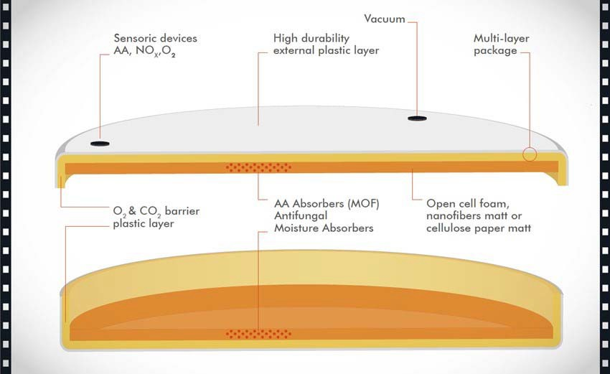
NEMOSINE CONCEPT
D The SMART PACKAGE concept:
D All the individual elements will be integrated in a smart package depending on the CH artefact deterioration grade and other requirements for protective or curative purposes.

Slide 11

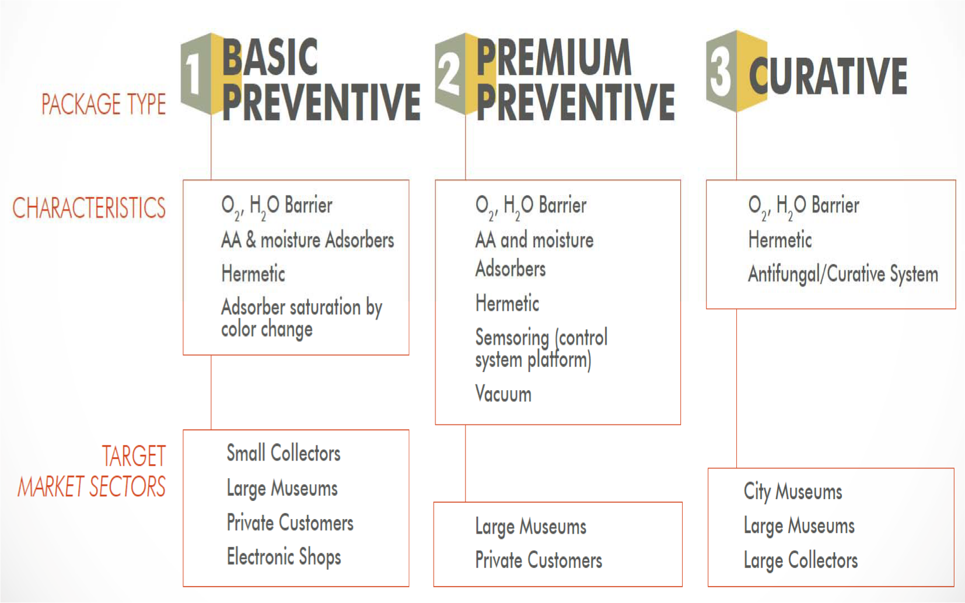
NEMOSINE SOLUTIONS
D The SMART PACKAGE solutions:
D The modular concept of a whole protective device would allow to generate three different packages with different functionalities and final cost, depending on the technical protective/ preventive or curative purposes of cultural objects.

Slide 12
NEMOSINE INVOLVED TECHNOLOGIES (I)
► The Key Objectives achievement will be based on the following approaches:
► Working on innovative and new acetic adsorbers based on hydrophobic MOFs with high specific surface and porosity supported in different substrates, with high specific surface and porosity such as open cell foams and electrospinning nanofibers, as well as cellulose based on paper or matt board due its excellent properties as absorber, recyclability and limited cost.
► To design high oxygen and moisture barrier injected packages by combining different plastic materials with different barrier properties in non-conventional processes such as co-injection, over-moulding or in-mould labelling.

Slide 13
NEMOSINE INVOLVED TECHNOLOGIES (II)
► The Key Objectives achievement will be based on the following approaches:
► Active packaging for releasing non-aggressive active substances and moisture adsorbents to minimize the growing of fungus such as nanoparticles and antifungal peptides.
► In this sense, NEMOSINE project will develop two types of dispositive:
► Long-term protection, where using antifungal additives are controversial. The current tendency is to control the causes beyond the consequences maintaining the moisture content in a safe level.
► Curative treatment as a kind of “on-field disinfection package”, when the artefacts or objects are contaminated by the microorganisms, bacteria or fungus. Several antifungal additives will be placed instead MOFs, such as peptides, essential oils, nanoparticles, or quaternary ammonium.

Slide 14

NEMOSINE INVOLVED TECHNOLOGIES (III)
► The Key Objectives achievement will be based on the following approaches:
► Design a modular smart package that fulfil all requirements of selected CH (cultural heritage) artefacts, such as easy change and recyclable adsorption/antimicrobial systems, hermetic seal, vacuum to remove all the oxygen after packing for anoxic packaging and competitive cost.
► Development of Chemical sensors based on the use of nanotechnology, including electronic wireless devices, for degradation process monitoring, promoting the non-invasive techniques. Sensors integrated in the package will be designed to measure the following gases (acetic acid, nitrogen oxides, moisture and oxygen) all-in-one.
► To develop a model to link other vapors to a degradation level. It will allow to predict the years before a severe degradation appears, in order to know when other conservation works are needed.

Slide 15

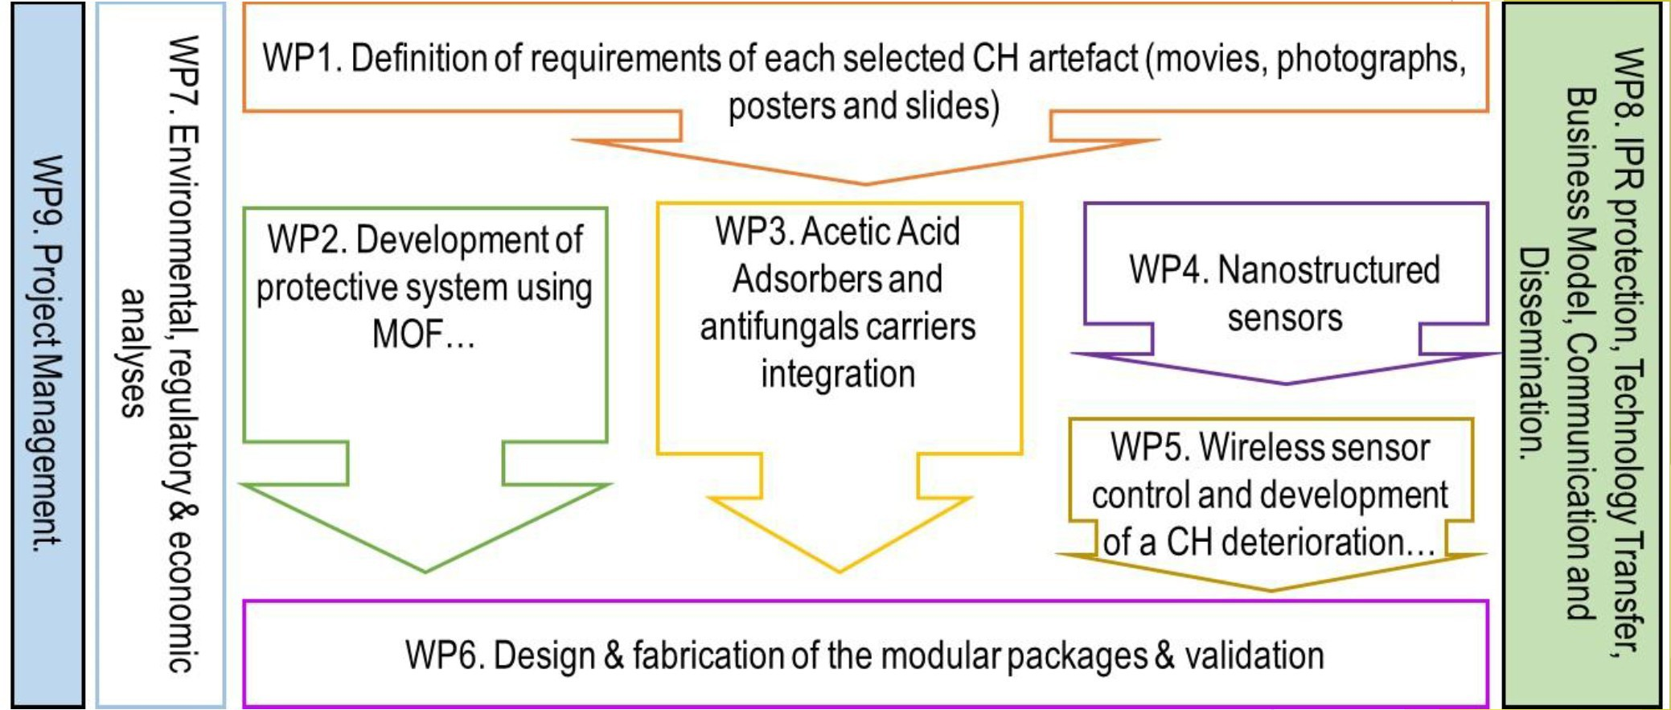
NEMOSINE WORKPLAN
□ Workpackages inter-relationship (PERT):

Slide 16

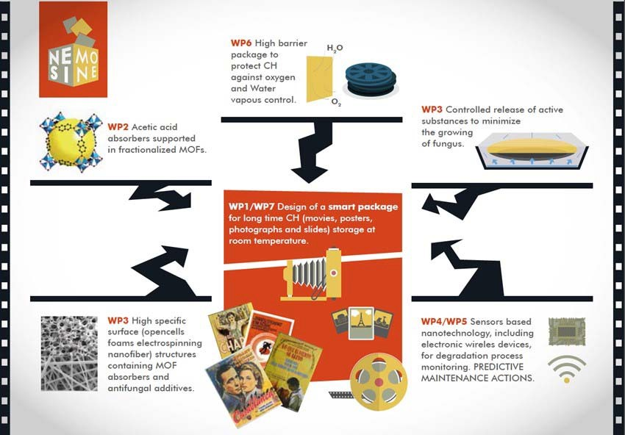
NEMOSINE WORKPLAN
► The Partnership structure around a common objective:

Slide 17
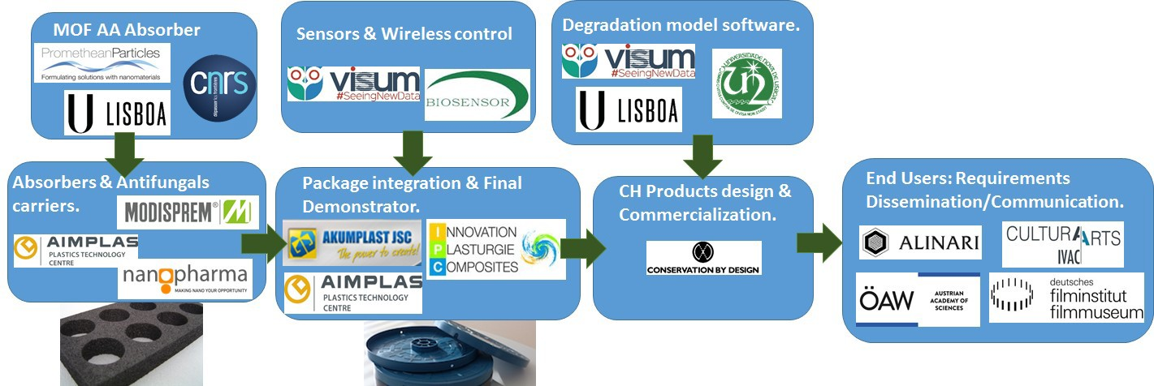
NEMOSINE CONSORTIUM

Slide 18



Thanks for your attention!
PAOLA.DEPOLO@ALINARI.IT
WWW.ALINARI.COM
WWW.NEMOSINEPROJECT.EU
GA760801 funded by

