Slide 1




Innovative packaging solutions for storage and conservation of 20th century cultural heritage of artefacts based on cellulose derivative
Visual1st Conference
San Francisco–October 3-4, 2019
ANDREA DE POLO SAIBANTI
FRATELLI ALINARI IDEA SPA
GA760801 funded by

Slide 2

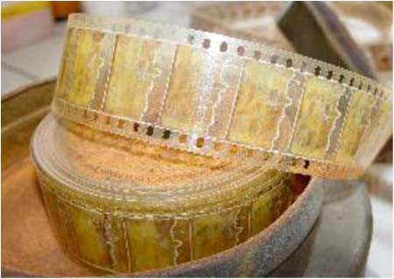

NEMOSINE INTRODUCTION
◆ The facts:
◆ A huge percentage of the recent European cultural heritage (CH) can be found in movies, photographs, posters and slides produced between 1895 to nowadays were made using cellulose derivatives.
◆ The worldwide estimation of such holdings within professional film archives is around 18 Mio of film reels on cellulose acetate, whereof ca. 5% are in a critical stage or showing signs of vinegar syndrome.
◆ There have had other technical approaches to solve this real problem that follow the line of replication and copy the original ones in modern digital supports but, they do not give the possibility of a real preservation of the original ones.

Slide 3
NEMOSINE OBJECTIVES
◆ The Key Objectives:
◆ NEMOSINE aims to improve the traditional storage solutions, by developing an innovative smart package with the main goal of energy saving and extent conservation time of cultural objects based on cellulose derivatives.
◆ The smart package will have the following characteristics:
◆ High O2 barrier and Active packaging using non-odor additives.
◆ Active acid absorbers based on functionalized Metal Organic Framework (MOFs) integrated in low density and porous structures.
◆ Gas detection sensors based on nanotechnology to monitoring AA, water, O2 & NO.
◆ Multi-scale modelling to correlate degradation & sensors signals for maintenance prediction and integrate all these technologies.
◆ Packaging with modular design to fulfil the technical & economical requirements of the different CH made by cellulose derivatives.
◆ Curative packages containing controlled release of natural antifungal additives.

Slide 4
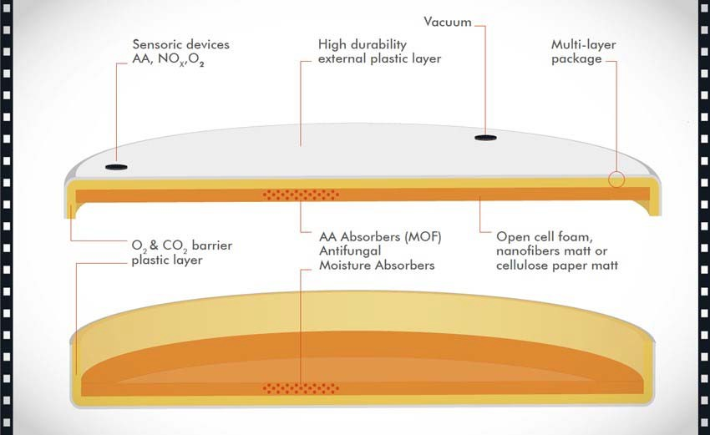
NEMOSINE CONCEPT
◆ The SMART PACKAGE concept:
◆ All the individual elements will be integrated in a smart package depending on the CH artefact deterioration grade and other requirements for protective or curative purposes.

Slide 5

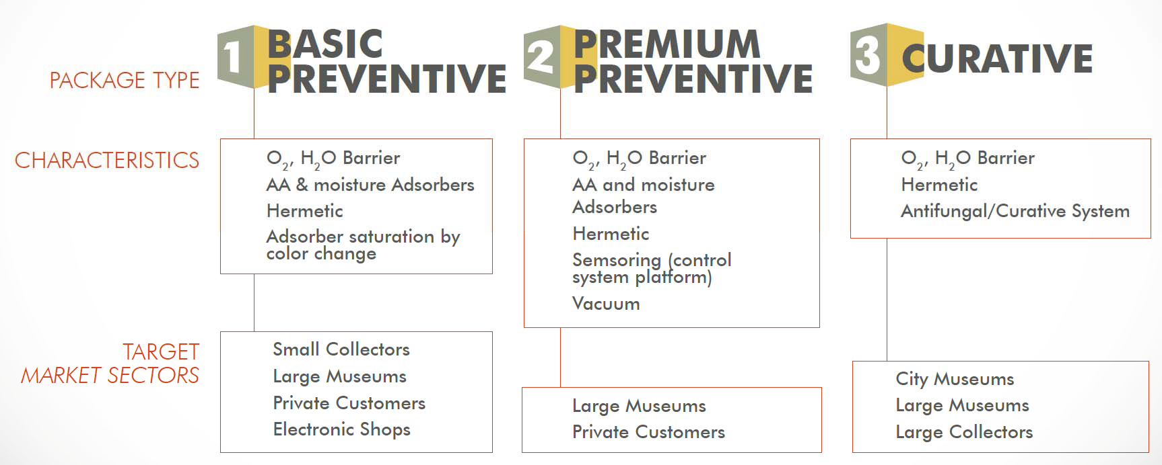
NEMOSINE SOLUTIONS
◆ The SMART PACKAGE solutions:
◆ The modular concept of a whole protective device would allow to generate three different packages with different functionalities and final cost, depending on the technical protective/ preventive or curative purposes of cultural objects.

Slide 6

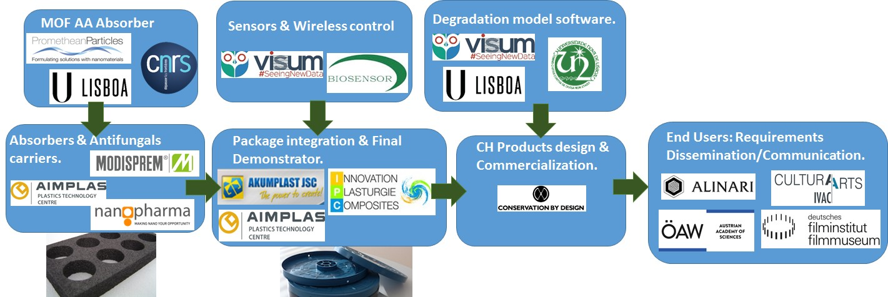
NEMOSINE CONSORTIUM
◆ Work flow relationships:

Slide 7

Thanks for your attention!
ANDREA DE POLO SAIBANTI
R&D MANAGER @ FRATELLI ALINARI IDEA SPA
ANDREA@ALINARI.IT
WWW.ALINARI.COM
WWW.NEMOSINEPROJECT.EU
GA760801 funded by

